Slide 1
ON ROAD SIGN DETECTION
Salvatore Macaluso & Bryan Parada
3/14/18

Slide 2
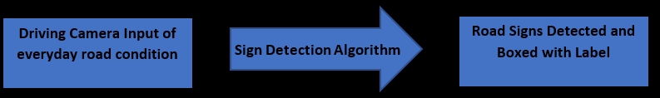
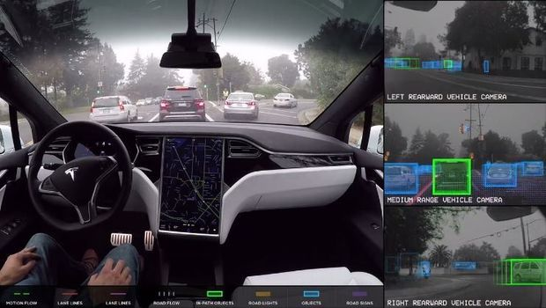
Road Sign Detection
Our problem is to recognize specific road signs encountered while driving.
Labeling the specific road signs with their appropriate name.
Related work, advancement of Autopilot Systems using Computer vision for real time detection of any and all road obstacles.
Inspiration & Related Work - Tesla Autopilot

Slide 3
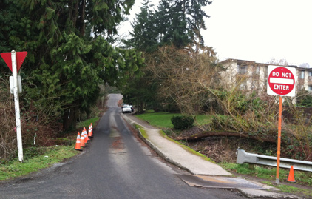
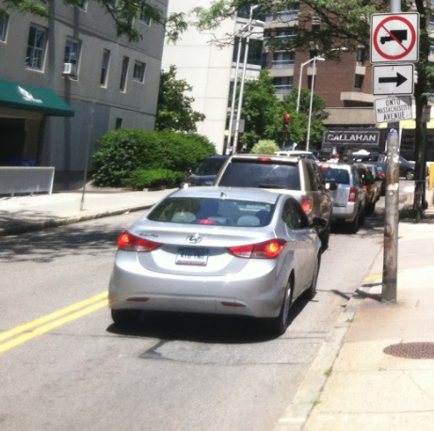
Technical Approach
Training a custom Cascade Object Detector.
Positive Image
Create a large training set for both positive and negative samples to train the object detector.
Using an Image Labeling Utility, create bounding boxes around pixels/image of interest to identify the object in any input image.
Export the positive labeled images as a table with coordinates of positives paired with the image. (Creating an X,Y Location, L,W Dimension)
Now using a Cascade Object Detector, adjust parameters to detect an object.
Negative Image

Slide 4
Cascade Object Detector
Cascade Classifier uses a sliding window over each image to detect if the image contains the object of interest.
The Detector will autoscale, but its aspect ratio remains fixed. (This makes the detector very sensitive to out-of-plane rotation, because the aspect ratio changes for most 3-D objects.)
Thus, a strong Positive Labeled Training Set is required.
Then runs through a predefined amount of stages, allowing possible positive matches to move on, while negatives get stuck on that stage.
If still positive by the last stage, image remains labeled.

Slide 5
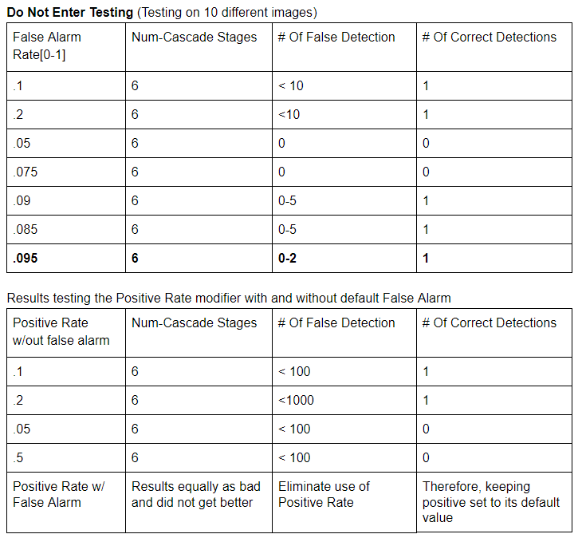
Results - Changing Cascade Parameters
Table contains the amount of correct versus incorrect detections of our sample set, by varying the Cascade parameters.
Higher Alarm Rates = Lower probability of finding negative samples.
Test Cases helped finalize the parameters to use on trainCascadeObjectDetector.
Since we have a small dataset < 1000 We decrease the number of stages and set a lower false positive rate for each stage to achieve the best results.

Slide 6
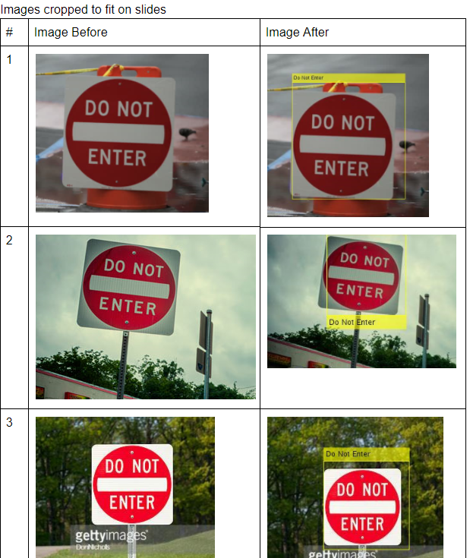
Do Not Enter Sign Results
Positive results were obtained with a high % Accuracy on 20 test images. Of the 20, we had 18 Accurate hits on the sign, and two complete misses. (3D Rotation)
The misses were on images with a rotation around its axis, since the aspect ratio changes on a 3D object as you rotate around it.
Fix: A stronger positive learned set, with many different 3D rotations around the object/sign.

Slide 7
Conclusion For On Road Sign Detection
Successful in our approach and execution, definitely should be made stronger with more data for positive training.
Not suitable for our original application of real time detection, although once your detector is trained it is much faster, it is still not 30FPS fast.
Future Work: R-CNN (Regions with Convolutional Neural Networks) - Instead of classifying every region using a sliding window, the R-CNN detector only processes those regions that are likely to contain an object. This greatly reduces the computational cost incurred when running a CNN. Which makes it much more realistic for real time image processing.

